Slide 1


Celebrating Stories
With Green Flame Books
Story Ideas: Places

Slide 2


Jack
Reusen
and the
Fey
Flame
by
John Bray

Slide 3


1. Somewhere different
What’s the most opposite place to where you are right now?
  What is that place like?
  Is it scary or safe?
  Is it exciting or boring?
Writers call this new place your 'setting’.
Take it further...
Show us some extra details about this place:
  What's the weather like there?
  What would you write with in this new place? A feather quill on a scroll of paper, or a futuristic tablet with a bossy hyper-intelligent AI?

Slide 4
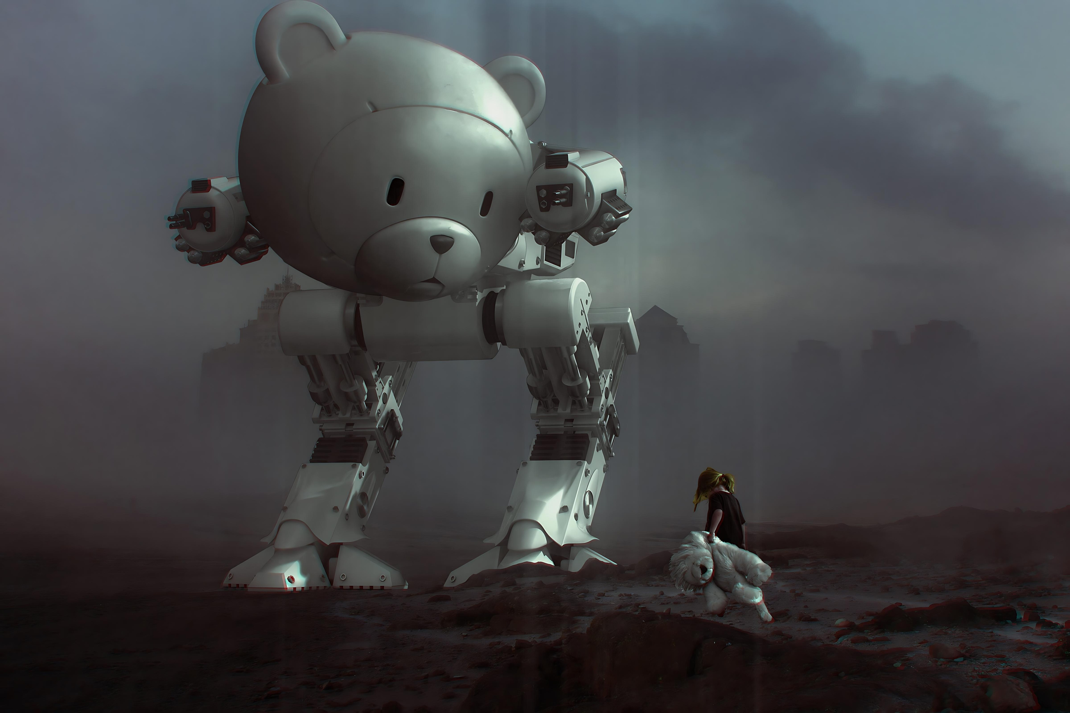
2. A stranger
Let’s take a look around.
  Is anyone there?
  Who are they?
  Are they a human, an animal, or something else?
This stranger is your 'main character'.
Take it further...
Let’s get some extra ideas about your character:
  What are they doing?
  What mood are they in?
  What do they think of you?

Slide 5
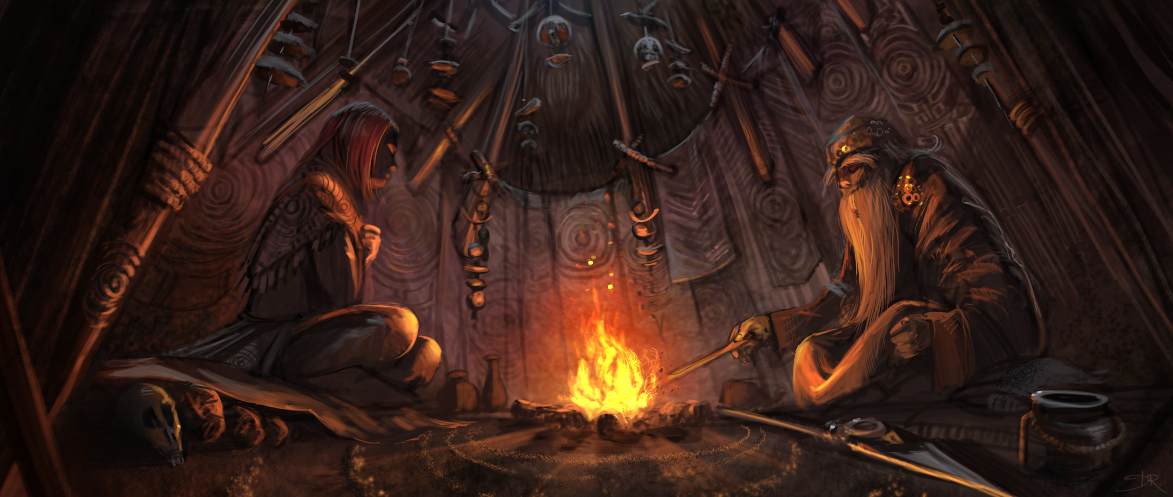
3. Getting to know people
Get to know your character. Ask them a few questions.
  What do they like to do?
  What scares them?
  What might they eat for breakfast?
  Where do they sleep?
Take it further...
Imagine ‘interviewing’ your character:
Ask ‘weird’ questions, ‘boring’ questions, and hard questions. There are no wrong questions.
  Who are their favourite people?
  Why are they speaking to you?
  What would they like to be doing this time tomorrow?

Slide 6


4. Go and write
Show what happens next.
  Will something surprising happen to your character?
  What will they do?
  Will they be happy in the end?
Write your story in your best handwriting or draw an amazing picture.
Take it further...
Are you surprised at the direction your new story took?
When you feel your story has reached a natural end, please be sure to share your stories on the Celebrating Stories portal.
Go here for the google form (or click this link)
Every week we read a few new stories on the podcast.
Yours could be next!

